Slide 1
Concepts in Computer Science (for Biologists)
Python Programming for Biologists Seminar Series
R. Burke Squires
NIAID BCBB

Slide 2
Advanced Concepts
Data Structures
Algorithms
Big O Notation
P vs NP Problem
Dynamic Programming
Greedy Programing
Development Methodologies
Waterfall
Agile Development
Parallel Computing
Embarrassingly Parallel
Graphical Processing Unit (GPU) Computing
Machine Learning
Deep Learning
DevOps
Version Control
Continuous Integration
Containers (Docker)
Cloud Computing
Other
Application program interface (API)?
Common Workflow Language (?)

Slide 3
Data Structures
Array (or list)
Hash Table (dictionary)
Heap
Graph
Linked List
List
Queue
Stack
Tree
Binary search tree
Table comparing data structures
Mutable, immutable
Ordered, unordered
What they are called in different programming languages
For animations of data structures, please see here:
https://www.cs.usfca.edu/~galles/visualization/Algorithms.html

Slide 4
Data Structures
Array
Hash Table
[x, y, z]
An ordered set of data
A set of variables that each store an item
After deleting an element:
[x, , z]
Data Structure Visualizations: https://www.cs.usfca.edu/~galles/visualization/Algorithms.html

Slide 5
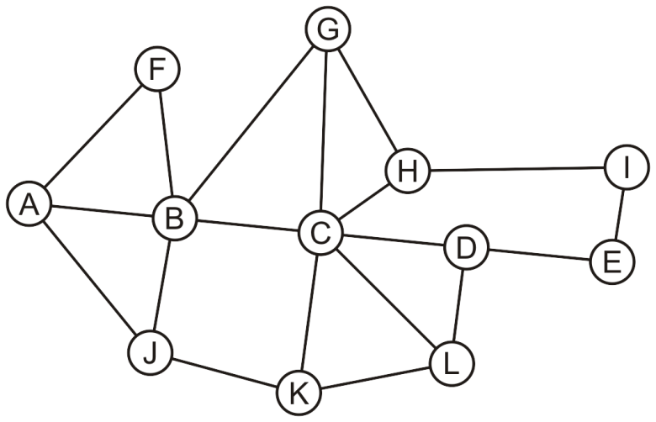
Data Structures
Graph
List
[1, 2, 3, 4, 5, 6]
An ordered set of data
A set of items
After deleting an element:
[1, 2, 4, 5, 6]
undirected graph

Slide 6
Data Structures
Linked List
Queue
First in, First Out Queue
Source: https://en.wikipedia.org/wiki/Linked_list
https://en.wikipedia.org/wiki/Queue

Slide 7
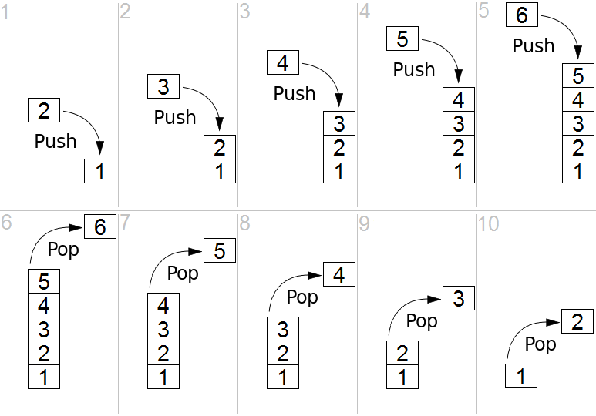
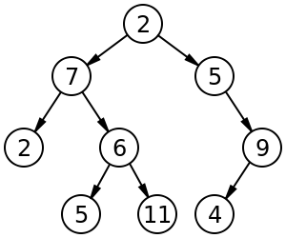
Data Structures
Stack
Tree
Last in, First Out

Slide 8
Algorithms

Slide 9
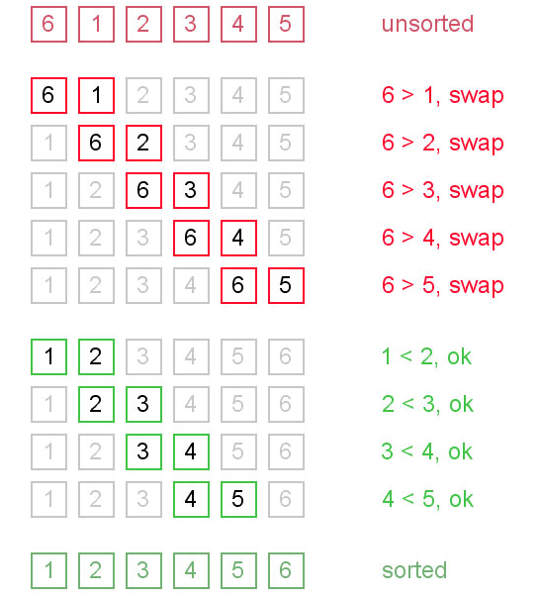
What Is An Algorithm
Definition
Noun
A step-by-step procedure for solving a problem or accomplishing some end especially by a computer <a search algorithm> (Merriam-Webster)
In other words…a “recipe” or “protocol” for the computer
Bubble sort algorithm
Compare two numbers, if number on left is bigger, swap
Repeat

Slide 10
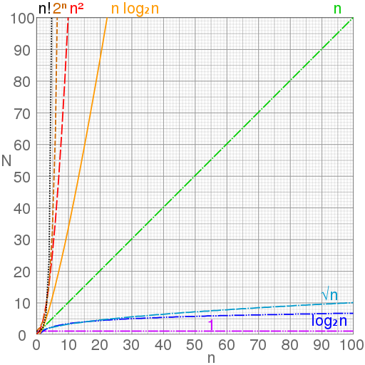
Big O Notation
Pick a number between 1 and 10
I will tell you if the number if too high or two low
How many guesses do you need to get the number? Usually 3 – 4 or nearly log(10)
Now how many guesses do you think it would take if the options were to a million?
Big O Notation
Approximately how long an algorithm will take to run

Slide 11
Big O Notation
Growth Rate | Name | Code Example | Description
1 | Constant | a= b + 1; | statement (one line of code)
log(n) | Logarithmic | while(n>1){ n=n/2; } | Divide in half (binary search)
n | Linear | for(c=0; c<n; c++) { a+=1; } | Loop
n*log(n) | Linearithmic | Mergesort, Quicksort, … | Effective sorting algorithms
n^2 | Quadratic | for(c=0; c<n; c++) { for(i=0; i<n; i++) { a+=1; } } | Double loop
n^3 | Cubic | for(c=0; c<n; c++){ for(i=0; i<n; i++){ for(x=0; x<n; x++){ a+=1; } } } | Triple loop
2^n | Exponential | Trying to break a password generating all possible combinations | Exhaustive search
http://adrianmejia.com/blog/2014/02/13/algorithms-for-dummies-part-1-sorting/

Slide 12
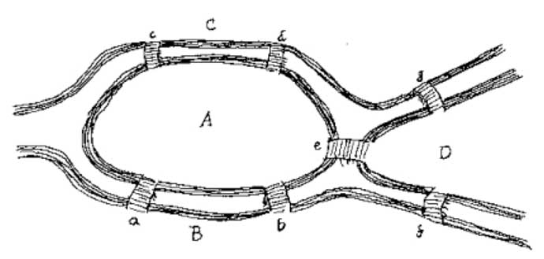
Algorithms P vs NP Problem
Polynomial versus nondeterministic polynomial time
How long it takes to solve a problem versus how long it takes to verify there is a solution
NP-complete problems
Harder to compute than verify
Example
7 Bridges
Euler wondered if a person could walk across each of the seven bridges once and only once to touch every part of the town.
Notes:
Euler…Starting and ending at the same spot was not a requirement

Slide 13
Dynamic Programming
Method for solving a complex problem by breaking it down into a collection of simpler sub-problems
Solving each of those sub-problems just once, and storing their solutions
The next time the same sub-wwwwwwwwwwwwwwwproblem occurs, instead of recomputing its solution, one simply looks up the previously computed solution
Notes:
Figure 1 - The filled dynamic programming matrix for two DNA sequences, x = TTCATA and y = TGCTCGTA, for a scoring system of +5 for a match, -2 for a mismatch and -6 for each insertion or deletion.
From the following article
What is dynamic programming?
Sean R Eddy
Nature Biotechnology 22, 909 - 910 (2004)
doi:10.1038/nbt0704-909

Slide 14
Greedy Programing
Problem solving heuristic of making the locally optimal choice at each stage with the hope of finding a global optimum

Slide 15
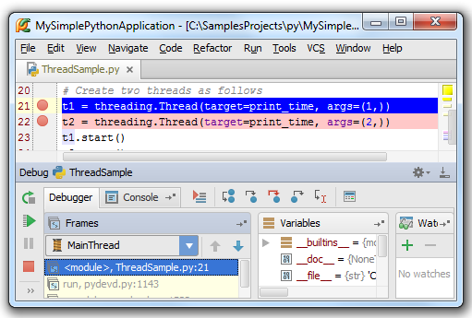
Debugging
Majority of programming time
75 – 80% of programming
How
Can use print statements or
Integrated development environment (IDE) software
Software to write software
Set break-points
See what is happening in program during execution

Slide 16
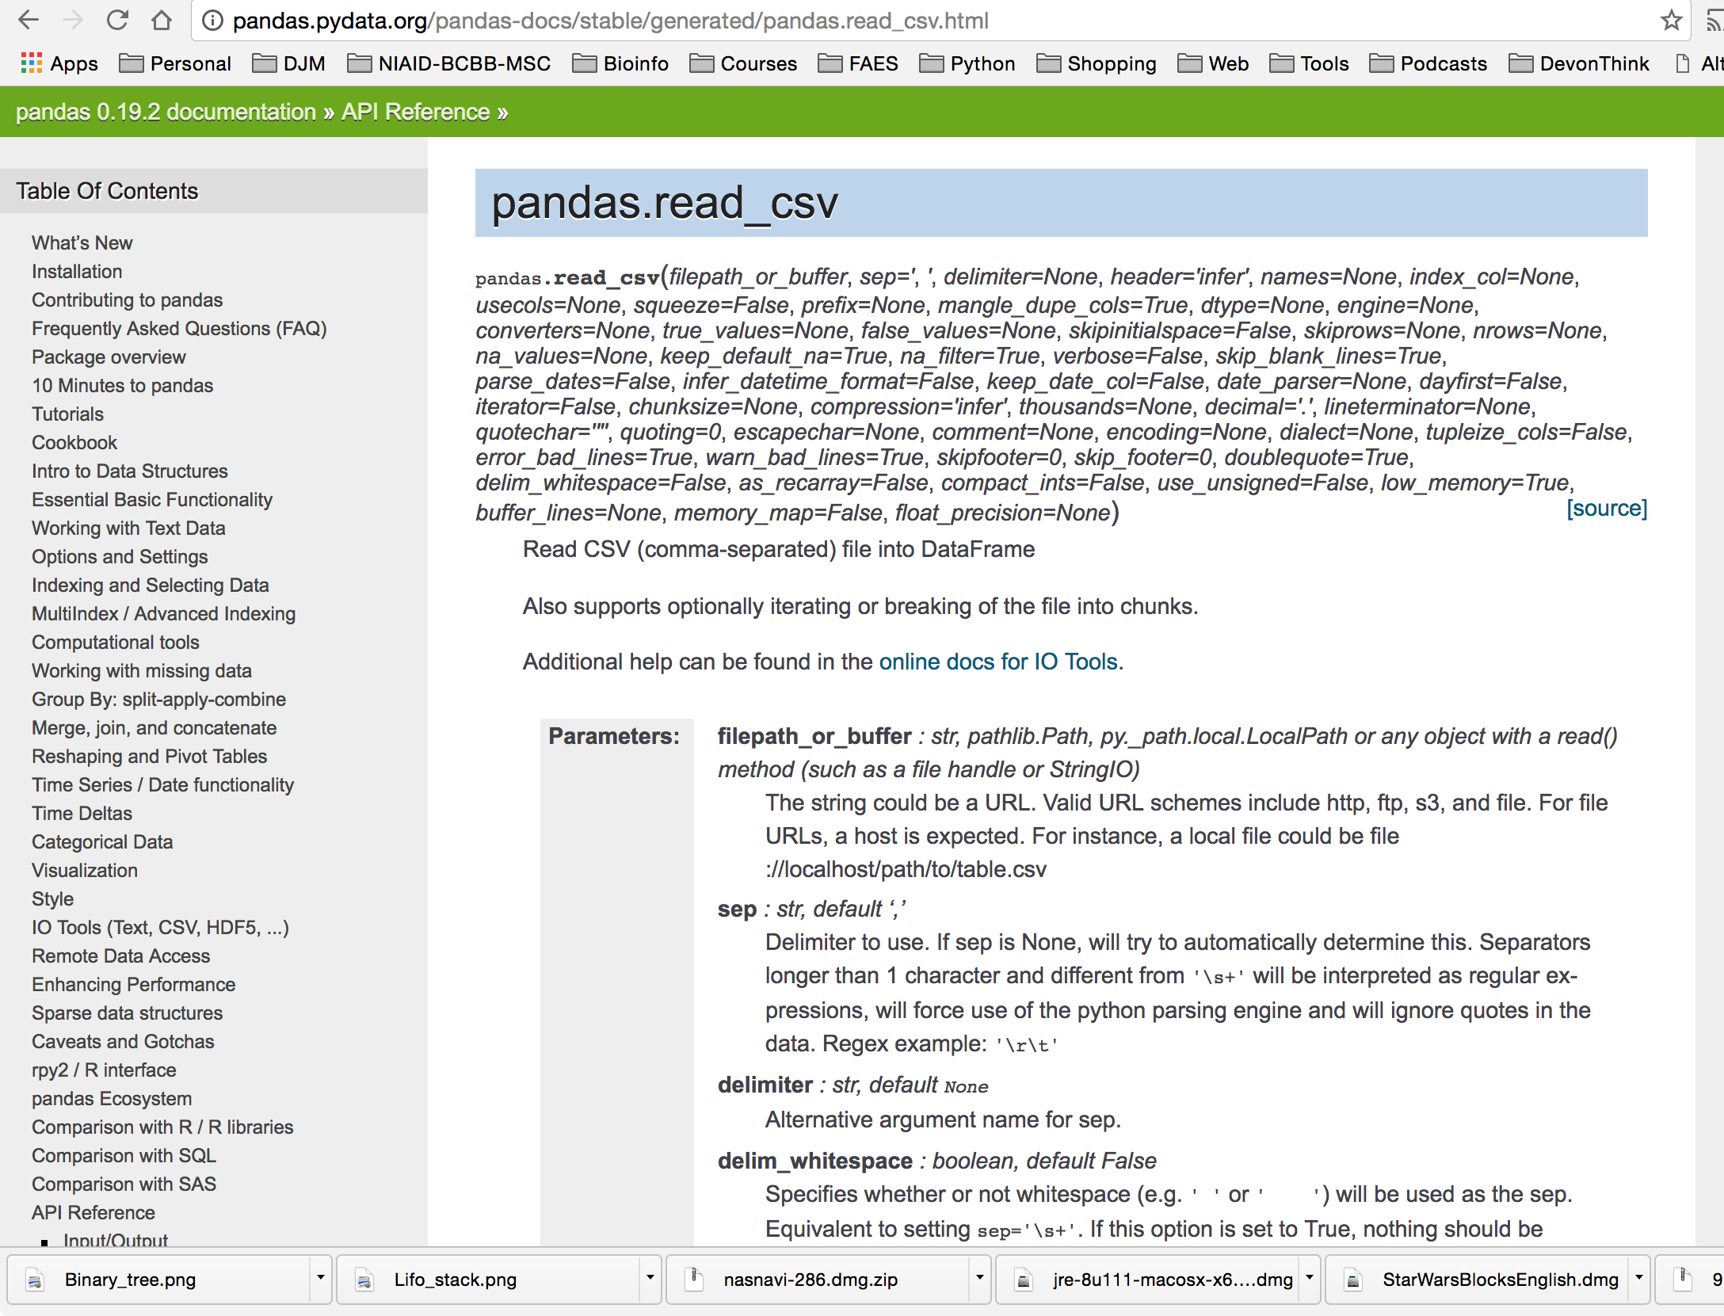
Application Program Interface (API)

Slide 17
Test-driven Development
Testing your software
How
Unit test
Assert
TDD Procedure
Write test before writing code
Only write enough cost to pass test
Write another test
Repeat
# content of test_sample.py
def func(x):
return x + 1
def test_answer():
assert func(3) == 5

Slide 18
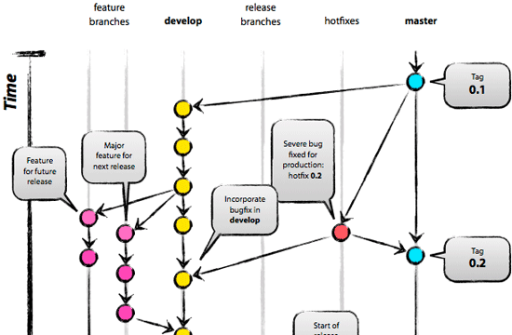
Version Control
Keep track of changes (versions)
Always have a working copy
Create branches to add or test features
Merge branches
Enables multiple programmers to work at the same time

Slide 19
Development Methodologies
Waterfall
Agile Development
Do all planning
Write all code
Perform all tests
Release product
Concern
Very difficult to do all planning in beginning and anticipate all problems
Iterate
Plan one part
Write code to part
Test one part
Release one part
Repeat

Slide 20
Parallel Computing
Breaking a problem into smaller subparts
Running each smaller part on separate core or computer
OR
Run same code with many different parameters at once
Single data stream
SISD, MISD
Multiple data streams
SIMD, MIMD, SPMD, MPMD
Also
Embarrassingly Parallel

Slide 21

Graphical Processing Unit (GPU)
Central Processing Unit
Graphical Processing Unit
Intel Processor – Pentium, i7, Xeon
“Brain” of laptop and servers
2, 4, or more “cores” / little brains
Graphics cards / Video cards
Up to 3584 NVIDIA CUDA® Cores
Up to 12 GB RAM
Must write specific code or use specific packages

Slide 22
Machine Learning
Machine Learning
Deep Learning
“Learning”
Supervised learning
Support vector machines
Artificial Neural network
Bayesian methods
Random Forests
Unsupervised learning
Clustering
Dimensionality reduction
Structure prediction
Uses artificial neural network
Multiple hidden layers in network
Tries to model the way the human brain processes light and sound into vision and hearing
Needs training
Has been shown to out perform experts with minimal training

Slide 23
Development - Operations (DevOps)
Combination of programming (development) and operations
Operations
Hardware, software that are used to run websites, software
Utilizes
Version Control
Continuous Integration
When new update to software is detected (using version control), automatically runs test, compiles and puts into production
Containers (Docker)
An abstraction of hardware (software pretending to be hardware)
Allows one to download a single “file” with everything needed to run some doftware

Slide 24
Cloud Computing
Really more then just a computer
Infrastructure, management, etc
Essentially renting a computer or part of a computer
AWS, Google Cloud, Microsoft Azure
Quick to setup and scale

Slide 25
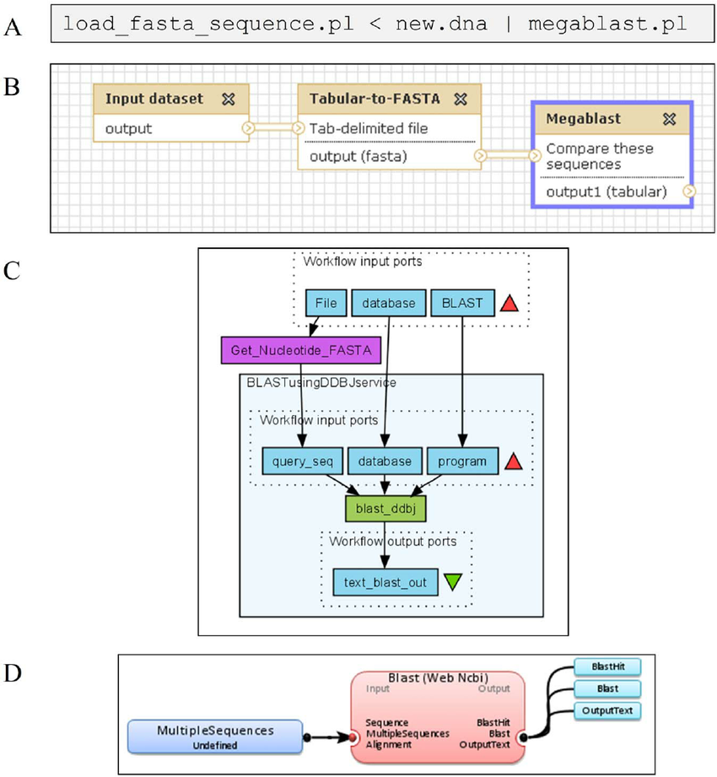
Workflow / Pipeline
The combining of multiple programs to steps into a single process
Enable
Automation
Scaling
Reusable
Reporting
Common Workflow Language
New standard for writing workflow instructions
Armadillo 1.1: An Original Workflow Platform for Designing and Conducting Phylogenetic Analysis and SimulationsArticle in PLoS ONE 7(1):e29903 2012
Notes:
Figure 1. Comparison of four different bioinformatics platforms for sequence search (i.e., the BLAST algorithm is used in all of them). Panel (A) presents a standard pipeline using Perl scripting; Panels (B, C, D) show different workflow designs for the sequence search operation provided by Galaxy (B) [10], Taverna (C) [27] and the introduced Armadillo workflow platform (D). doi:10.1371/journal.pone.0029903.g001

Slide 26
Getting Started

Slide 27
Learning Objectives
To familiarize you with computer programming, programming languages, scientific packages
Enable you to communicate better with programmers, bioinformaticians
Critique existing source code for your use
Assess which language that bests fits your needs
Facilitate you becoming a reproducible scientist
Notes:
Update

Slide 28
Resources
Algorithms
https://www.manning.com/books/grokking-algorithms
https://www.toptal.com/developers/sorting-algorithms
General python
https://docs.python.org/3/tutorial/index.html

